Slide 1
Business Case Study
By Piyush Dhorey

Slide 2
Problem Statement
A fast-growing fintech start-up has built a user base by providing a payment platform for users. They are now looking to build a credit product and make it available to their customer base. Credit products come with huge risks, and they want the Data Science team to help them with a model/solution which will enable them to do risk profiling of potential customers for the credit product.

Slide 3
Approach Towards Problem Statement
Assessing any customer for credit products is based on different kinds of data formats and tools which are used by P2P business models to extract useful knowledge, which can make an impactful analysis whether the customer is eligible and if eligible what other requirements are necessary.
Some factors may include, customer’s annual salary, existing debts, churn, credit score and history, employment status etc.
Every credit product, let’s assume a credit based pay later system, assigned to a particular customer has specific limit for credit and interest rate which is calculated by there previous credit history. If the credit history is approximate to 80%-90% of the eligible margin then various favorable schemes can be provided by the company to the customers.

Slide 4
If a customer, let’s assume is applying for a credit based pay later system, irrespective of even if they belong to existing user base, they would have to undergo a predictive system analysis.
Such predictive analysis would require a large dataset and tools according to market standards. This is typically used in decision making process of accepting or rejecting the credit loan.
This predictive system is based on a statistical model which, based for information about the borrower ex. Age, annual salary, nationality, existing debts and in some cases, credit score.
These statistics helps in distinguishing “good” and “bad” credit loans, which gives a real time estimate of probability of risk evaluation.

Slide 5
Gathering of Data
For creating a predictive analysis model, a large amount of data is needed which can be either structured data or unstructured data.
Unstructured data is accumulating from a variety of sources in ever-increasing numbers, providing considerable analytical potential.
The dataset which is used for establishing the model, is gathered from Kaggle named FinTech_user.csv. This data file contains the data of a fintech company’s user base, which can be used to improve customer’s relationship and service.
The dataset contents are user id, age, housing(rent or other), credit score, received loan, rejected loan, cc taken and many other. Only limited parameters of these are required to predict user’s credit analysis and future potential credit.

Slide 6
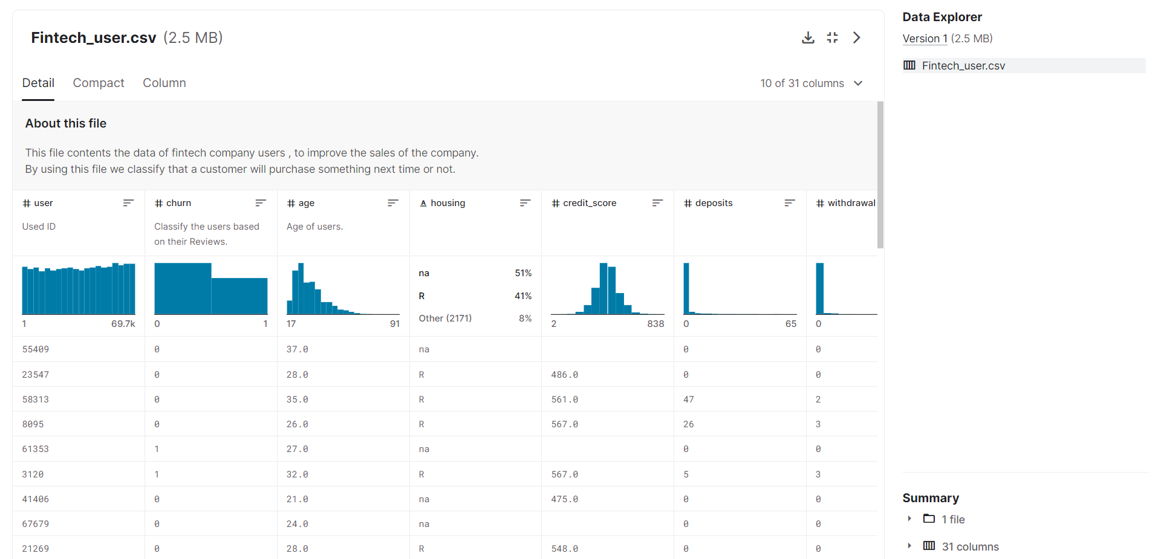

Slide 7
Cleaning and Exploration of Data
After extracting the data, the analysis model does not require un-necessary parameters or columns from dataset. Here, data cleaning is to be done using pythonic commands and libraries. The libraries used to clean the data and rearranging are Pandas and NumPy.
Firstly importing the required dataset as a data frame, all the columns would be visible. Only necessary columns needed for the analysis model. Using commands we need to drop the unnecessary columns.
After cleaning the data, these are the only parameters which would be requiring to categorize and identify risk-free potential customers.

Slide 8
Required parameters from the user base is as follows:
user: see whether the customer is user or not | age: verify whether the customer has eligible credit age.
credit score: customer’s credit score should be valid between 450 to 700 | deposits: whether the deposits are frequent and on-time by the customer
housing: whether the place of customer is rented or owned. | purchases: purchases through the company’s website or app.
cc_taken: whether the customer owns a credit card. | withdrawal: whether the withdrawals frequent through app or website.

Slide 9
Solution or Model
Risk assessments are important part to give consumer competitive rates using variety of sources to guarantee that no stone is left unturned.
In order to manage large amounts of data sets either structured or unstructured to recognize hidden patterns and relationships among variables provided, data mining is aimed to.
This model will help in analysing the behaviour of customer using the user data and provide services according to there needs.
It can also recommend, let’s assume a credit based pay later system, what could be the best suitable credit with flexible tenure and good interest rate according to the user’s previous credit deposits/withdrawal.

Slide 10
When recommending the user for credit using there previous credit history, this would help in sorting risk-free customer from overall applicants.
Understanding through model, let’s assume a customer requiring a credit loan from the fin-tech company,

Slide 11
User
user id identification
Age
age verification
Credit score
needed credit score verification
Housing
House rented or owned verification
Purchases
number of purchases done through platform
Deposits
deposits frequency
Withdrawal
Withdrawal frequency
Credit Card taken
does customer already owns a credit product
Success

Slide 12
From this model, a risk-free customer evaluation could be executed with exact predictive success rate.
Each process takes 12.5% rate to get the success rate of 100%, without this the customer could not be defined as a potential risk-free customer.

Slide 13
Thank You

